Slide 1
© 2018 by Softek Solutions, Inc. Unauthorized duplication or distribution of this document is prohibited.

Slide 2
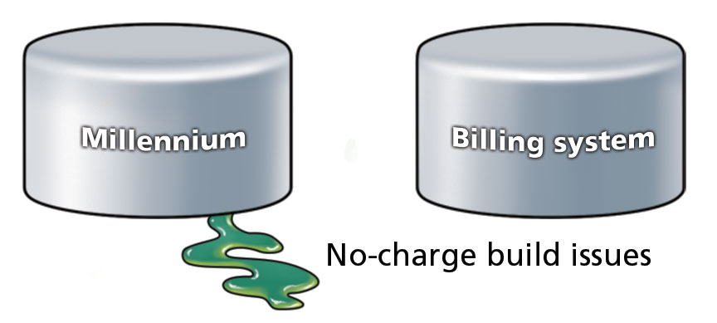
What Others See…

Slide 3
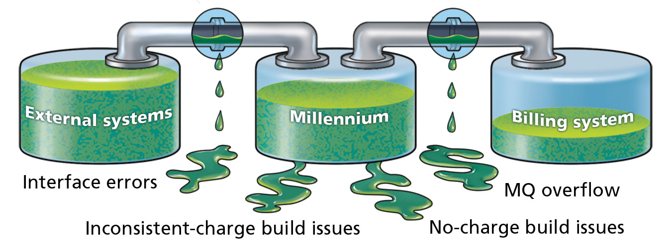
What We See…
Notes:
We equip you with the proper tools to do your job!

Slide 4
What We See…
Notes:
We equip you with the proper tools to do your job!

Slide 5
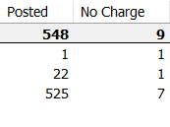
Inconsistent Charges
When an orderable sometimes posts a charge and sometimes “no charges.”

Slide 6
Inconsistent Charging Examples
Location Issues
Pyxis Machine not set up
New facility/nursing unit added
Registration Issues
Picking incorrect encounter type
Charge Point Issues
Workflow “skips” charge point

Slide 7
What We See…
Notes:
We equip you with the proper tools to do your job!

Slide 8
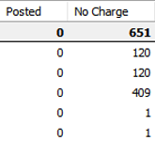
No Charge
When an orderable completes but never posts a charge.

Slide 9
No Charge Examples
Missing CDM
Missing Charge Point
Missing Bill Item/Bill Code

Slide 10
Missing Charges
Could any of these scenarios be happening at your organization?

Slide 11
Case Study
“INCONSISTENT” and “NO CHARGE” Orders Issue

Slide 12
Problem
Client converted “Big Bang” to Cerner Millennium, including Revenue Cycle.
Three months post-conversion, annualized revenue was significantly less than expected.
Neither Cerner consulting nor the client could find what caused the dip.

Slide 13
Pain
Client was:
Down in revenue.
Losing trust in implemented EMR.

Slide 14
?
Where is the
MONEY

Slide 15
When Did Softek Engage?
Softek engaged three months after Go-Live.

Slide 16
How Did Softek Engage?
Softek provided a consultant to help gather charging details.
Used Softek’s proprietary Charge Integrity Control (CIC) to identify gaps in charging.

Slide 17
How Did Softek Engage?
Found inconsistent charging issues in two departments:
General Lab
Anatomic Pathology (AP)
Identified “No Charge” issues within two departments:
6 Blood Bank orderables
10 Gen Lab orderables

Slide 18
Inconsistent Charging Issues
Softek’s Charge Integrity Control identified that the “no charge” orders were coming from the same location: “LabWorks”
Softek’s consultant met with the lab director who agreed that charges should be received from this location.

Slide 19
Inconsistent Charging Issues
Charges were not posting when orders were placed in Requisition Order Entry (ROE) because it was not designed for organizations to be associated through the ROE client tier.

Slide 20
Softek’s Suggestion
Set up charging for the ROE workflow so any orders placed through this application would post charges.

Slide 21
“No Charge” Issues
Softek’s consultant met with the department heads to identify the correct list of orders that should be posting charges.
One orderable had been ordered 19,327 times since conversion and never posted a charge.

Slide 22
Summary & Impact to Client
Inconsistent Charges
$800K of charges were recovered in Gen Lab and AP since Go-Live ($3.2M annualized).
“No Charge” Issues since Go-Live:
Blood Bank accounted for $753,411 (over $3M annually).
Gen Lab accounted for $3,190,096 (over $12.7M annually).
Other departments accounted for $7.2M annually.
Total Missing Charges Found: $26.1M annually.

Slide 23
!
Back in
BLACK

Slide 24
Questions

Slide 25
© 2018 by Softek Solutions, Inc. Unauthorized duplication or distribution of this document is prohibited.

